Slide 1
Team 5282
Durand, MI - Railroaders

Slide 2
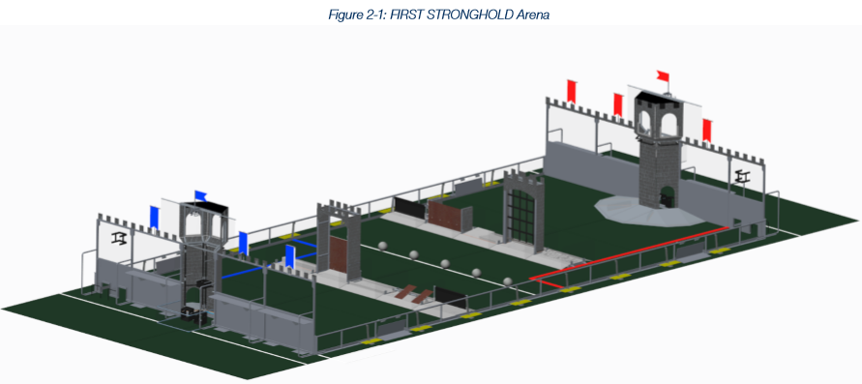
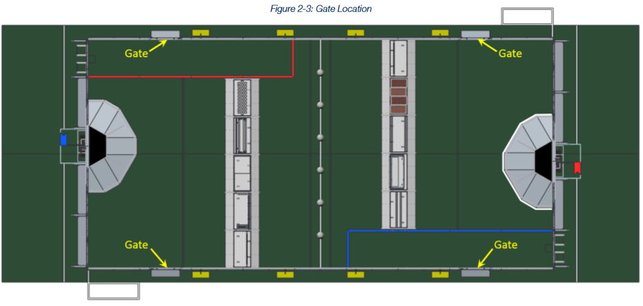
Field Layout
Field Dimensions: 26 ft 7in * 54ft 1in
Courtyard: 16 ft
2 in Alignment line measured 11 ft from castle wall (parallel with driver wall). One defensive robot. In last 20 seconds defensive robot can not touch other robots
Outworks
Neutral Zone
Midline (6 boulders)
Secret Passage
Boulders are placed in filed from the human player. Two low holes and one high. Only go in and out through the courtyard. Can’t touch an offensive robot in their secret passage.

Slide 3
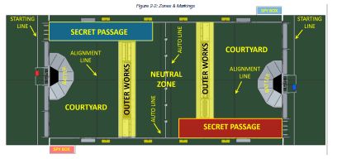
Match Set-Up/Times
Full match 2 min 30 sec
Auton 15 sec
Tele-op 2 min, 15 sec
Drive Team:
Drivers: 2
Human Players 1: Spy, bowling, boulder control
1 Driver Coach
Robot:
Neutral Zone must be breaking the plane of the auto line (across the line) on the opposite side of the field from scoring tower.
Inside the courtyard in contact with the castle wall or courtyard and guard rail. Spy bot

Slide 4
Robot Constraints
Height: 4’6” max until the last 20 seconds of match
Perimeter 120 inches without bumpers
Weight: 120 pounds excluding battery and bumpers
Nothing allowed more than 15 inches outside the frame
Boulder has to be able to be removed at all times by a human with robot powered off.
Only can control one boulder at a time
Boulder can be inside or outside the bot

Slide 5
Game Rules
1 Robot Defensive Pinning: Can pin for 5 seconds and then must wait for 3 seconds. If the pinned robot comes at the pinning robot, the time is void.
Only one robot can be in our courtyard at a time.
Last 20 seconds, we can’t block their robots.
All three robots must be on the batter at the end to capture the tower.
8 boulders in tower to weaken it. One extra boulder per technical.

Slide 6
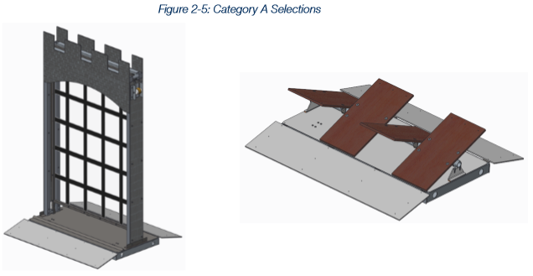
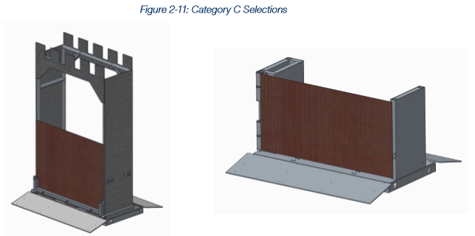
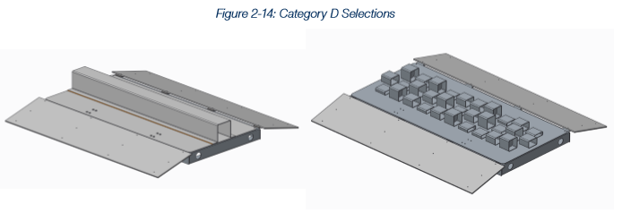
Field Elements/Pieces
(Defenses) Outer Works (8) - Must pick one from each section
A
C
B
D

Slide 7
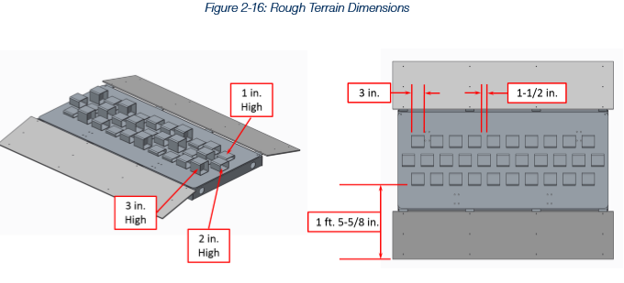
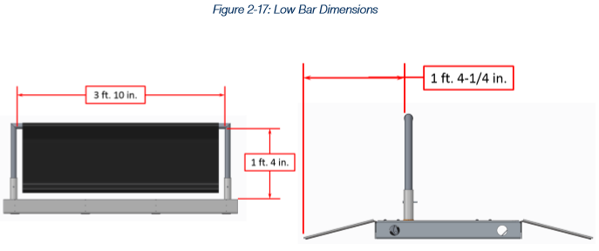
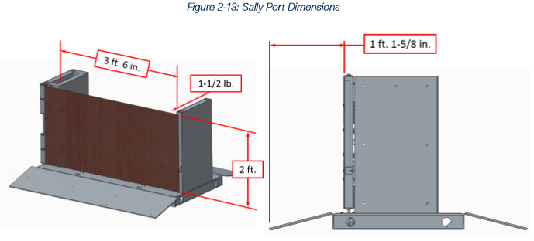
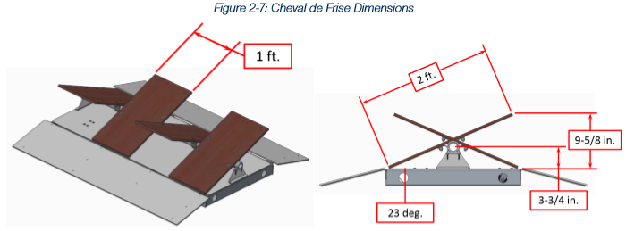
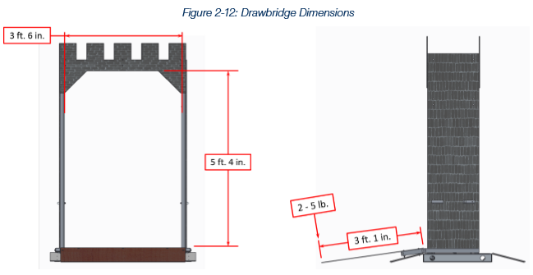
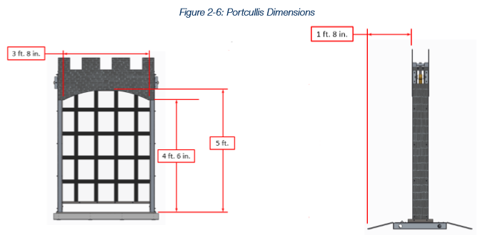
Field Pieces
B
D
Outer Elements (9) total, (8) Changeable
Low bar is always on the field 1’4” 3’10”touching edge of field
Fixed
Stone wall
Moat
Rough terrain
Ramparts
Moveable
Low bar
Sally Port
Draw Bridge
Cheval de Frise
Portcullis
Rough Terrain
We pick three, one is fixed, one from the crowd
C
A

Slide 8
Game Point Breakdown: Autonomous
What can we do?
Reach (2)
Cross the defense (10)
Boulder in high (10)
Boulder in low (5)
What can we not do?

Slide 9
Points
Crossing an undamaged defense 5 points
Shooting into high goal 10 points
Shooting into low goal 5 points
Breaching 1 ranking points
Scale 15 points per robot

Slide 10
Team Priorities/ Goals for robot design
Boulders in tower
Get across their defense
Scaling Tower
End on the batter to capture in last 20 seconds
Defending our tower
5 Types:
Defend
Shoot
Transfer Boulders
Breaking Defenses
Scaling

Slide 11
2016 First Robotics Competition: Stronghold

